Slide 1

Video chat application
Sandeepsivaram S Sashikumar N
Visweswaran A Srinath M
Venkat Raj V

Slide 2
INTRODUCTION
ABSTRACT
Chatting is now-a-days very useful to express our ideas as well as receive others ideas on any topic. Chats reflect the recent trends of the society. Sometimes, it is possible to meet eminent people in chatting and have their advice.
Our application makes video calling a pleasant experience. It has excellent features that make any user do whatever he wants while chatting.

Slide 3
The demand for social networking sites is increasing day by day.
A social networking site that allows you to video chat online is the primary inspiration for my project.
The goal of my project is to build an online video chatting tool that enables users to join real-time streaming video chat rooms where users can share their video with another person.

Slide 4
Some of the existing video chat applications are Stickam, YouCam, ichat, blogtv.
My online video chat tool offers similar functionality like these social networking sites, and it is simple to execute and doesn’t have to rely on any third-party sites.
Users can directly enter webcam chat room. Also, this video chat application doesn't require any additional software installation on the client side.

Slide 5
IMPLEMENTATION
When the given code is executed and uploaded to the server, the assigned url is opened
After giving access to video and mic a url is created after randomly after a user goes into the website url
When the url is shared to the person who wants to call, a successful video call is made.
An example diagram is shown below.

Slide 6
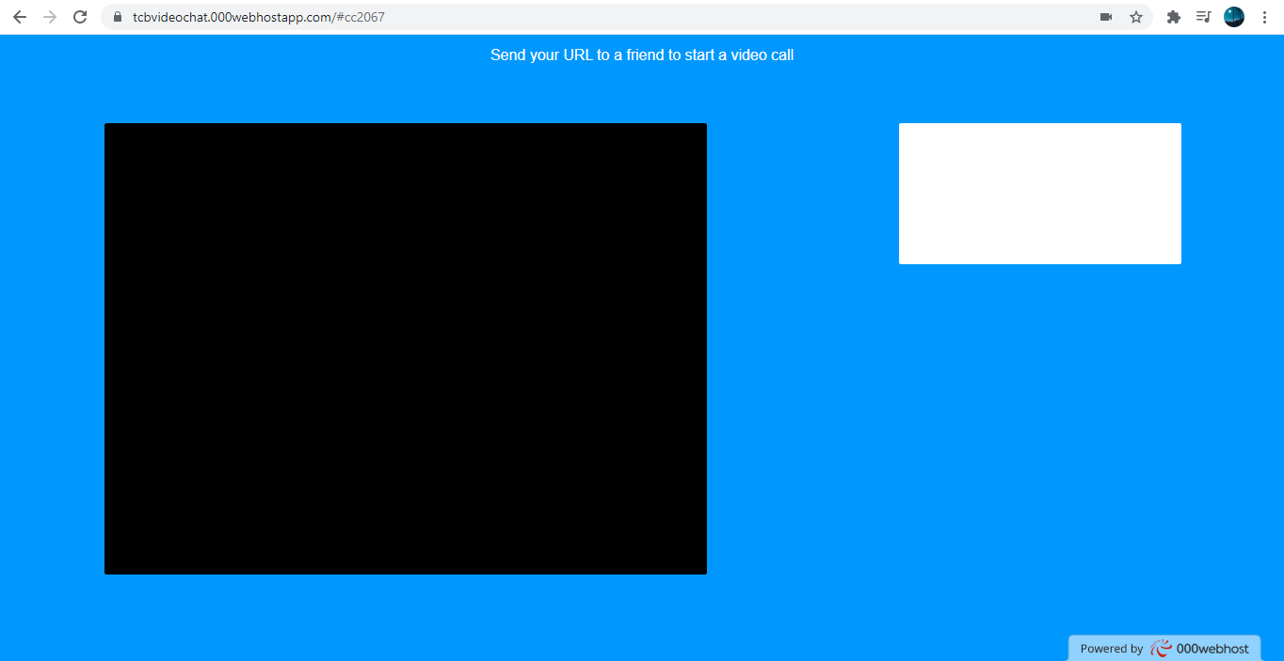
WORKING:

Slide 7
CONCLUSION
Thus, a video chat application was created using the given code and executed successfully. The application can be used to communicate between two individuals by sharing their url after opening the link if they have a webcam and a mic.

